Slide 1

Mortality Trends and Health Determinants in Heart Disease
Presented by,
Ashlin George.

Slide 2
Reason For Analysis
Jan. 27, 2023 – Cardiovascular-related deaths increased dramatically in 2020, marking the largest single-year increase since 2015 and surpassing the previous record from 2003, according to the 2023 Statistical Update from the American Heart Association.
https://www.webmd.com/heart-disease/news/20230127/us-heart-related-deaths-jumped-first-year-pandemic
Heart disease is the leading cause of death in the U.S. as well, causing approximately 69, 700 deaths per year. (Centers for Disease Control and Prevention, 2022)
https://www.singlecare.com/blog/news/heart-disease-statistics/
Approximately 121.5 million U.S. adults have some form of cardiovascular disease. (American Heart Association, 2019). https://www.singlecare.com/blog/news/heart-disease-statistics/

Slide 3
Dataset Overview
In the heart dataset, the binary output variable classifies individuals into two distinct groups: one representing a high-risk category(1) for heart disease and the other indicating a low-risk category for heart disease(0).
*CVD-CardioVascular Disease.
Data sources:
The Centers for Disease Control and Prevention(API ).
https://data.cdc.gov/resource/9dzk-mvmi.json
Kaggle
https://www.kaggle.com/datasets/rashikrahmanpritom/heart-
attack-analysis-prediction-dataset
The 'heart.csv' dataset provides valuable information about vital health indicators that can be correlated with heart disease.
The 'Trend.csv' dataset contains comprehensive information on mortality reasons and the corresponding number of individuals who passed away due to various causes from 2020 to 2022.

Slide 4
Key Questions for Heart Disease
01
Can we identify any patterns or trends in heart disease occurrence based on age groups (e.g., young adults, middle-aged, and elderly individuals)?
02
Does gender play a role in heart disease risk?
03
Are elevated blood pressure and cholesterol levels associated with a higher risk of heart disease?
04
Are higher heart rates associated with a greater likelihood of heart problems?

Slide 5

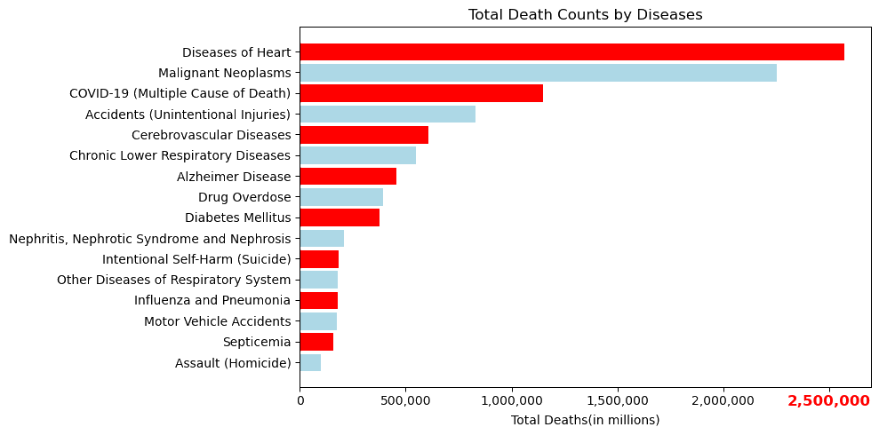
Trends in Mortality Rates(2020-2023)
From 2020 to 2023 in the USA, heart disease caused about 2.5 million deaths, more than any other disease.

Slide 6
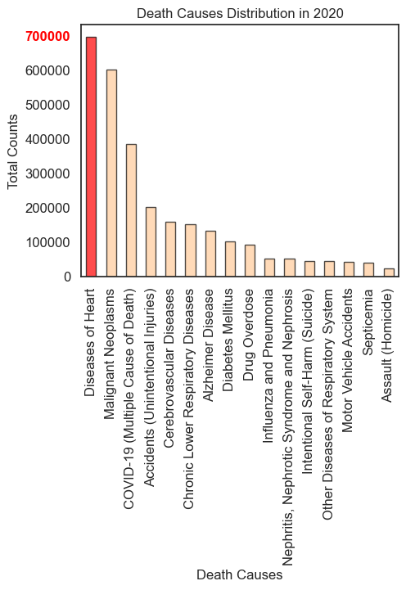
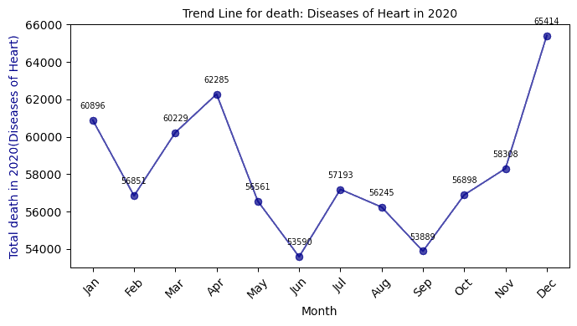
2020 Mortality (Heart Diseases)
High Mortality: In 2020, the highest mortality count recorded was 698,359 deaths, which surpassed all other causes of death for that year.
Peak and Trough: The peak mortality was recorded in December with 65,414 deaths, while the lowest was in June.
Fluctuating Trend Throughout the Year: The mortality trend observed from January to December 2020 showed mild fluctuations, indicating that the number of deaths varied month by month.

Slide 7
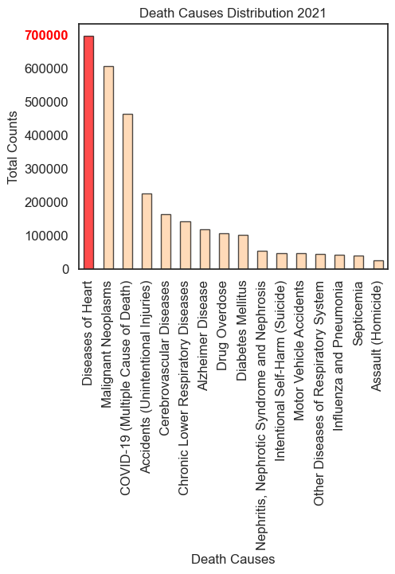
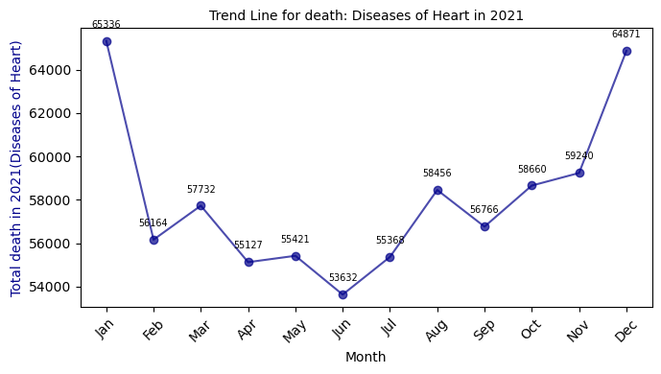
2021 Mortality (Heart Diseases)
High Mortality: In 2021, the highest mortality count recorded was 696,773 deaths, which surpassed all other causes of death for that year.
Peak and Trough: The peak mortality was recorded in January with 65336 deaths, while the lowest was in June.
Fluctuating Trend Throughout the Year: The mortality trend observed from January to December 2021 showed mild fluctuations, indicating that the number of deaths varied month by month, while the lowest was in June.

Slide 8
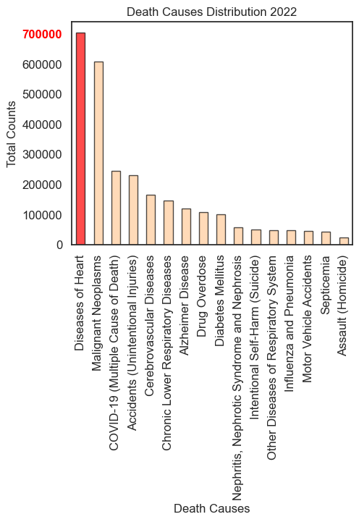
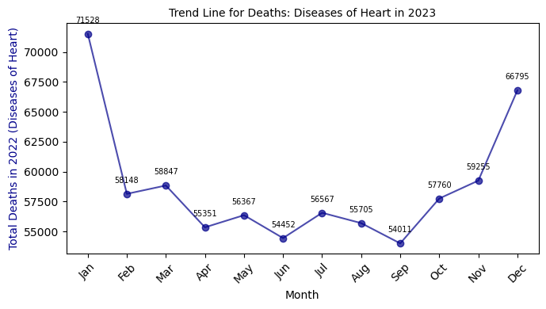
2022 Mortality (Heart Diseases)
High Mortality: In 2022, the highest mortality count recorded was 704786 deaths, which surpassed all other causes of death for that year.
Peak and Trough: The peak mortality was recorded in January with 71528 deaths, while the lowest was in June.
Fluctuating Trend Throughout the Year: The mortality trend observed from January to December 2022 showed mild fluctuations, indicating that the number of deaths varied month by month,while the lowest was in June.

Slide 9
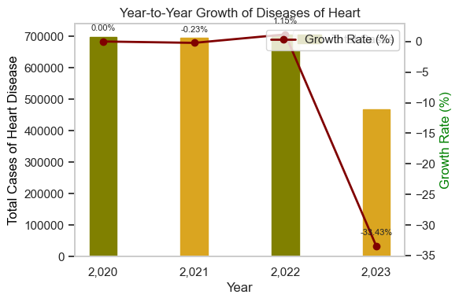
2000-2023 Mortality (Heart Diseases)
In 2021, a modest decline of 0.23% in heart disease cases hinted at possible small-scale improvements from health policies or natural variance. However, 2022 reversed this trend with a 1.15% rise.
Leading Cause of Death:Heart disease consistently ranks as the top cause of mortality, underscoring its significant impact on public health year over year.
Seasonal Variation in Mortality:An observable pattern shows peaks in heart disease deaths typically in January or December, suggesting potential seasonal factors influencing mortality rates.
Mid-Year Decline:Most years record the lowest numbers of heart disease-related deaths around mid-year, indicating a need to investigate the causes behind this regular decrease.

Slide 10
"Cardio Clues"
Univariate Analysis
Sex vs. Heart Risk.
Age vs Heart Risk
cholesterol vs Heart Risk.
Heart rate vs Heart Risk.
Studying how health vitals like blood pressure, cholesterol relate to the heart health can help us make specific plans to prevent them.
Bivariate Analysis
Age vs BP
BP vs Cholesterol
Categorical Analysis:
Chest Pain vs Heart Risk.
Exercise included vs Heart Risk.
Fasting Blood Sugar vs Heart Risk.
Cholesterol
Age
BP

Slide 11
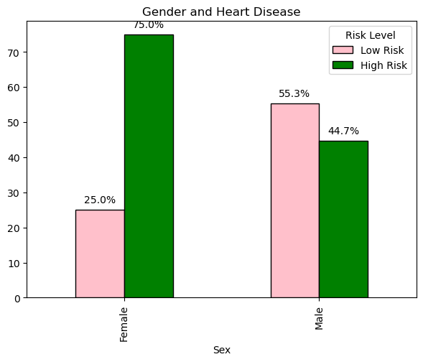

Heart Disease: It Affects Us All – Regardless of Gender
High Risk Prevalence:
The chart indicates that 75% of the female population is categorized as high risk for heart disease, which is a significant majority.
In contrast, males have a lower percentage of high risk at 44.7%, indicating that a smaller, yet substantial portion of the male population is at high risk.
Gender Discrepancies
The data suggests a pronounced disparity between genders, with females having a notably higher proportion of high-risk classification compared to males.

Slide 12
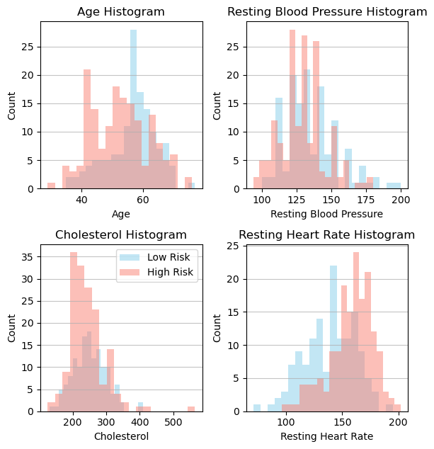
Univariate Analysis
01
The peak for high-risk cases is in the age range of 55-60 years.
Age appears to have no significant correlation with the risk of developing heart disease.
02
There is a noticeable number of high-risk cases in the blood pressure range of 125-140 mmHg.
Blood Pressure appears to have no significant correlation with the risk of developing heart disease.
03
High-risk cases increase sharply in the cholesterol range of 200-300 mg/dL.
There is a weak positive correlation between cholesterol levels and high risk for heart disease.
04
There is a noticeable number of high-risk cases in the heart rate range of 170-180 bpm.
Resting heart rate shows a positive correlation with high risk for heart disease.

Slide 13

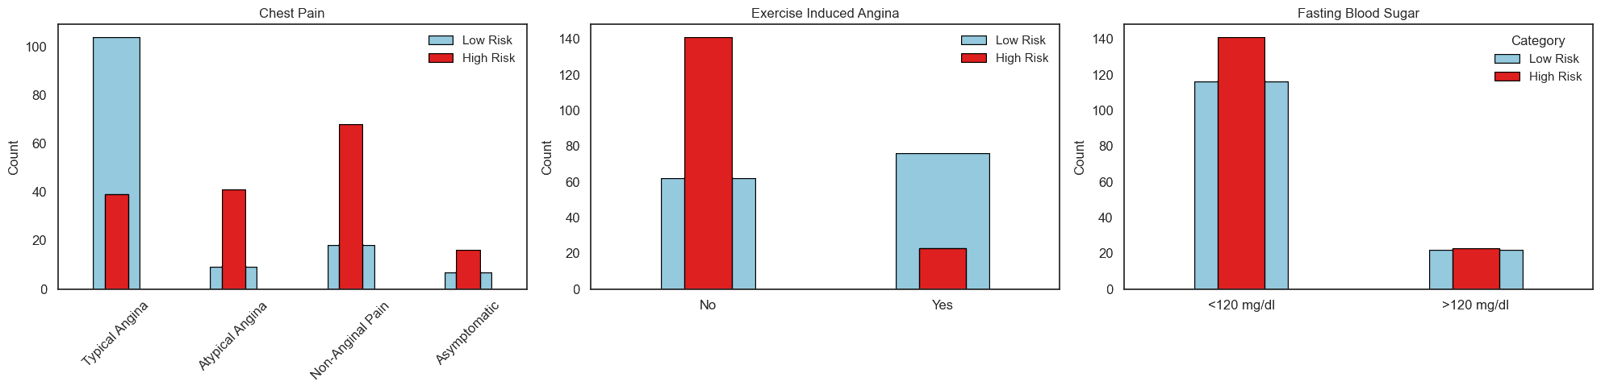
Categorical Analysis
Chest Pain:Has Correlation where patients with typical angina chest pain have a low risk of heart issues compared to those with other types of chest pain.
Exercise: Individuals who experience angina during exercise are at low for heart-related issues.
Fasting Blood Sugar: No clear correlation between fasting blood sugar levels and heart risk

Slide 14
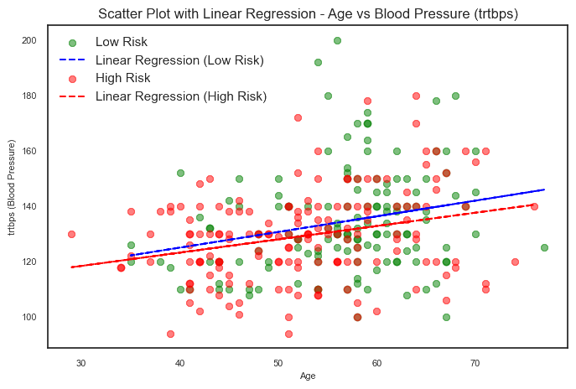
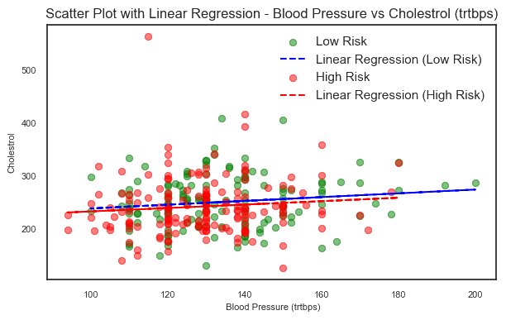

Bivariate Analysis
Age
vs
Blood Pressure
Blood Pressure vs
Cholesterol
The slopes of both regression lines are nearly flat, indicating that changes in blood pressure do not show a strong linear relationship with changes in cholesterol levels.
The data presented in the scatter plot does not show a strong linear relationship between blood pressure and cholesterol levels for either the low-risk or high-risk groups.
The slopes of both regression lines are nearly flat, indicating that changes in blood pressure do not show a strong linear relationship with changes in cholesterol levels.

Slide 15

Statistical Analysis
Categorical Data(Heart Risk ) vs Continuous Datas:(point-biserial test)
The point-biserial test used to measure the strength and direction of the relationship between a binary (dichotomous) variable and a continuous variable.
Categorical Data vs Categorical Data:(chi-squared (χ²))
The chi-squared (χ²) test used to determine whether there is a significant association between categorical variables.

Slide 16
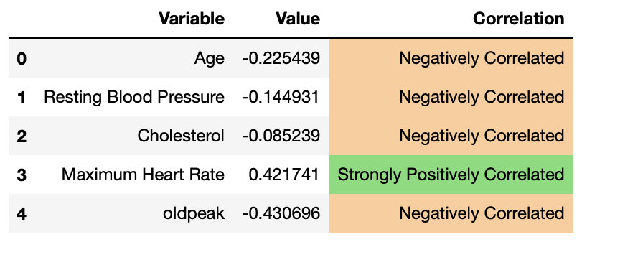
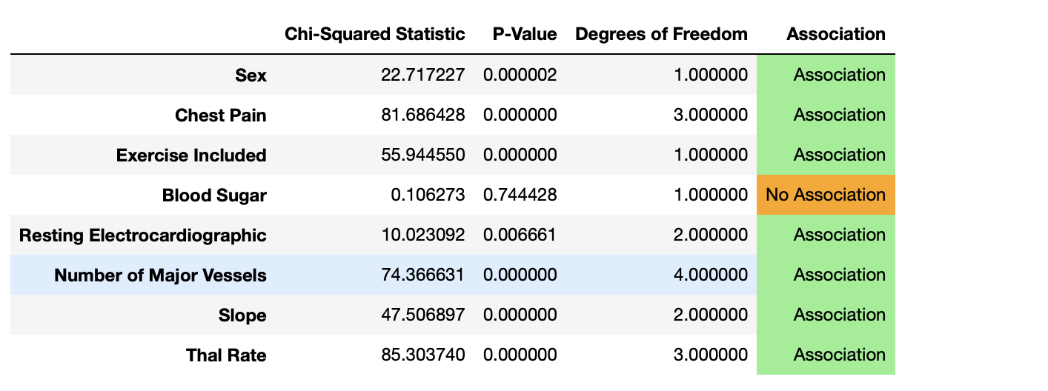
Test Result
Point Biserial:
As the maximum heart rate increases, the likelihood of heart disease also increases.
Age,BP,Max Heart Rate,Old peak are not correlated to the heart risk.
Chi-square test:
Chest Pain, Exercise Included, Number of Major Vessels, and Thal Rate are all marked as having an association with heart disease.
In contrast, "Blood Sugar" is marked as having no association.

Slide 17
ANALYSIS REPORT
Gender
There is a positive correlation, with females having a significantly higher (75%) proportion of high-risk cases.
01
08
Age The highest risk for heart disease is seen among individuals aged 55-60, but there doesn't appear to be a strong link between age and heart disease risk.
.
Max Heart Rate Resting heart rate shows a positive correlation with high risk for heart disease.High risk heart rate is 170-180 bpm.
02
07
Blood Pressure A significant number of high-risk cases have blood pressure between 125-140 mmHg, but there doesn't seem to be a strong connection between blood pressure and heart disease risk.
03
05
Cholesterol High-risk cases rise significantly between cholesterol levels of 200-300 mg/dL, but there's is no strong correlation between cholesterol and heart risk.
Chest Pain
Has correlation with the heart risk
were non-anginal pain is very frequent with high risk heart patients.
04
06
Exercise induced Individuals who experience angina during exercise are at low for heart-related issues.
Blood Sugar There are many high-risk cases with a resting heart rate of 170-180 bpm, and higher resting heart rates are associated with a higher risk of heart disease.

Slide 18
Limitations
The fact that gender, high resting heart rate, resting ECG, and chest pain are correlated, while age, blood pressure, cholesterol, and blood sugar are not, goes against what we usually expect based on common knowledge and medical understanding.
The way data is collected can influence the results. If the data was collected through self-reporting or surveys, it may introduce biases or errors, especially when dealing with subjective variables like chest pain.

Slide 19

Questions

Slide 20
Thanks for Listening

